Slide 1

Protein Interactions with Biomaterials and Surface Modifications
Louisiana Tech University
College of Engineering and Science
BIEN 235
Dr. Teresa Murray

Slide 2
Protein Adsorption
Louisiana Tech University
College of Engineering and Science
Body reacts to adsorbed protein on surface of biomaterials rather than the biomaterial*
* Material can also cause reactions if substances leach from material
Ratner et al., 2004
Notes:
Describe the diagram and what happens (they know about the existence of cell surface receptors but not much about intracellular signaling, so you don’t need to go into detail about the processes that are illustrated).
Read some, or all, of the possible activities from cell/biomaterial interactions (see list of 5 interactions in graphic).

Slide 3
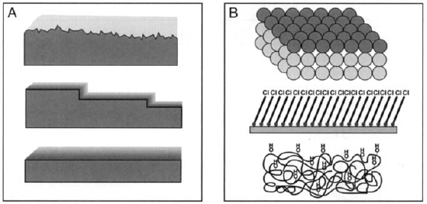
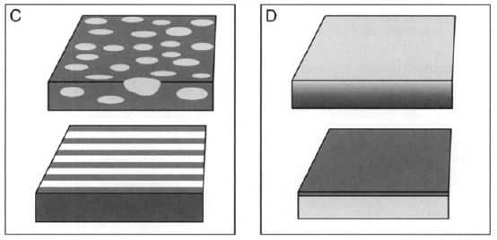
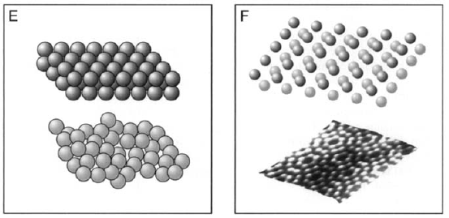
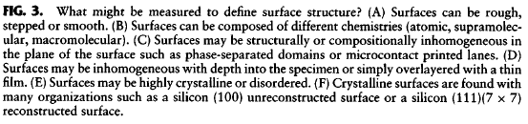
Louisiana Tech University
College of Engineering and Science
Surface structure affects tissue interaction-reaction
Figures from text: Ratner et al., 2004
Notes:
Describe the different surface structures shown in the figure (use the information in the caption – they won’t be able to see the caption in the classroom).
Some surface structures and surface chemistries are more prone to protein adsorption than others. Also cells contacting these surfaces may grow well on some surfaces and not on others.

Slide 4
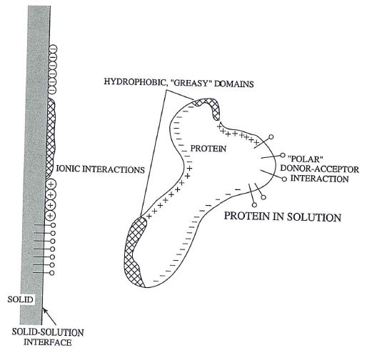
System properties governing protein adsorption
Louisiana Tech University
College of Engineering and Science
Domains
on surface and
on protein interact
Fig. 8.1, Temenoff and Mikos (2008) Biomaterials text
Notes:
Hydrophobic regions on proteins will bind to hydrophobic areas (domains) on surfaces of implanted materials. Charged regions of proteins will bind to oppositely charged domains on surfaces.

Slide 5
System properties governing protein adsorption
Louisiana Tech University
College of Engineering and Science
Surface attributes most affecting adsorption
_____________
_____________
Fig. 8.1, Temenoff and Mikos (2008) Biomaterials text
Notes:
Let’s review; the two surface attributes that most affect protein adsorption onto a material surface are
(1) CHARGE (Charge interactions), and (2) HYDROPHOBICITY (Hydrophobic and hydrophilic interactions).

Slide 6
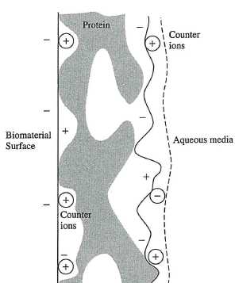
Schematic of adsorbed protein
Louisiana Tech University
College of Engineering and Science
_
+
_
Charge can play significant role in adsorption.
Like charges repel
Opposite charges attract
Counter ions (circled) can facilitate binding
+
_
_
_
_
Modified Fig. 8.2, Temenoff and Mikos (2008) Biomaterials text
Notes:
Extracellular fluid in the body has dissolved salts; so, it has ions. Free cations (+ charge) can bind to a negatively charges surface and a negatively charged domain in a protein, as shown in the diagram. Similarly, free anions (- charge) can bind to a positive area of a material and a positively charged domain of a protein.

Slide 7
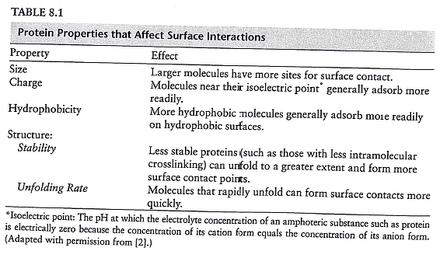
Louisiana Tech University
College of Engineering and Science
Table 8.1, Temenoff and Mikos (2008) Biomaterials text
Notes:
This is one of two tables that describe the properties of proteins that affect surface interactions. Briefly describe the 4 properties.

Slide 8
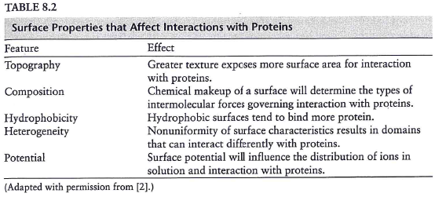
Louisiana Tech University
College of Engineering and Science
Table 8.2, Temenoff and Mikos (2008) Biomaterials text
Notes:
Describe these 5 other properties.

Slide 9
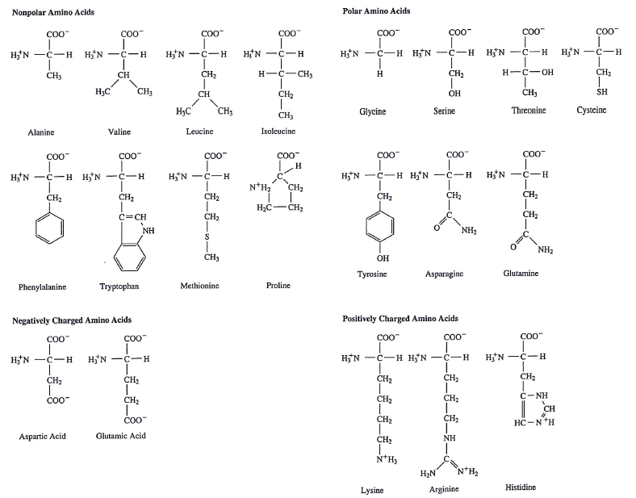
Amino acids affect higher protein structure
Louisiana Tech University
College of Engineering and Science
Proline
Ring structure in its backbone results in fewer degrees of rotational freedom
Cysteine
Sulfur in side group enables covalent disulfide bonding with other proteins
Fig. 8.4, Temenoff and Mikos (2008) Biomaterials text
Notes:
See information on slide.

Slide 10
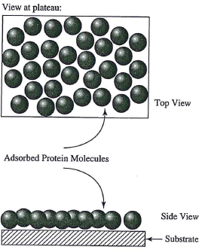
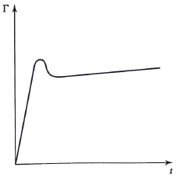
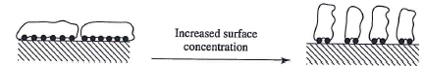
Rate of adsorption and rearrangement
Louisiana Tech University
College of Engineering and Science
< 1 s.
Fig. 8.14 - 16, Temenoff and Mikos (2008) Biomaterials text
Notes:
Within ~1 s, proteins in the body adsorb (adsorb, NOT absorb) to the surface of a material that is placed in it. In absorption, a substance penetrates into the bulk of a material; like a sponge absorbs water. In contrast, adsorption is when a substance sticks to the surface.
The proteins on the surface rearrange and more protein adsorbs.

Slide 11
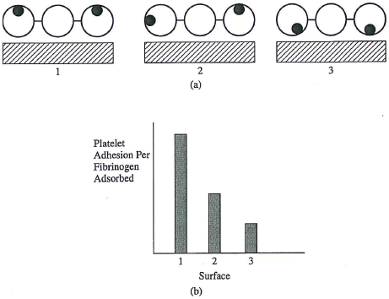
Fibrinogen deactivation over time
Louisiana Tech University
College of Engineering and Science
Platelet binding sites
Final conformation impacts usefulness
Fig. 8.17, Temenoff and Mikos (2008) Biomaterials text
Notes:
Proteins are not rigid structures; they can denature (which is to lose the native shape). This slide is a cartoon that depicts a protein, fibrinogen, that was intentionally adsorbed onto the surface. Fibrinogen has blood platelet binding sites. (1) Originally, the binding sites were oriented outward. (2) But other parts of the protein had a greater affinity for the surface and changes in shape occurred, which helped lower the Gibbs free energy of the protein-surface system. (3) Over time, the proteins changed shape to the point where most of the binding sites were oriented toward the surface and the coating lost much of its ability to bind platelets. This can be seen in the histogram which has maximum binding at stage 1, reduced binding at stage 2 and poor binding at stage 3.

Slide 12
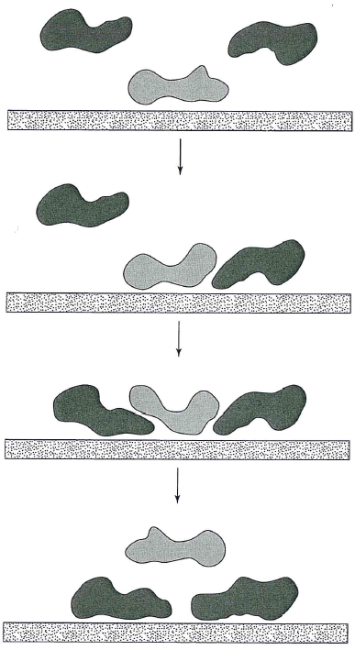
Vroman effect
Louisiana Tech University
College of Engineering and Science
Protein A with highest concentration usually binds first
Protein B with highest affinity (most thermodynamically favorable binding) eventually has highest concentration on surface
← Proteins unfold and spread
Fig. 8.18 Modified by TAM, Temenoff and Mikos (2008) Biomaterials text
Notes:
Another way that proteins rearrange on a surface is called the Vroman effect. Proteins that do not have a high affinity for the surface will not bind tightly and can be easily moved out of the way by proteins that have higher affinity.
In this example, Protein A has highest concentration, so it will usually adsorb first. Protein B has higher affinity for the surface (most thermodynamically favorable binding); so it displaces most of the Protein A molecules and eventually has highest concentration on the surface.

Slide 13
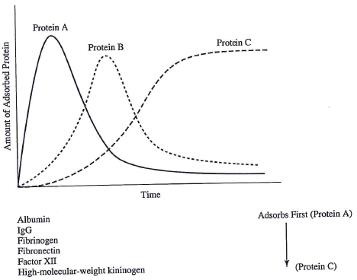
Vroman effect
Louisiana Tech University
College of Engineering and Science
Concentration
Fig. 8.19, Modified by TAM, Temenoff and Mikos (2008) Biomaterials text
Notes:
This is an example of how the amount of 3 different proteins on a surface changes over time. As the previous slide stated, the protein with the highest concentration surrounding the surface binds in the largest amount at first. This would be protein A in the plot. But protein B, which is in lower concentration, has a higher affinity (attraction) for the surface. Over time, B displaces much of A. Protein C is in even lower concentration, but has the highest affinity for the surface. It eventually displaces A and B to become the predominant protein on the surface.
Lower left: Several proteins are common in blood; they are listed in order of concentration.

Slide 14
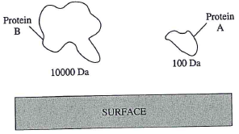
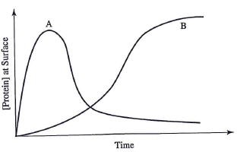
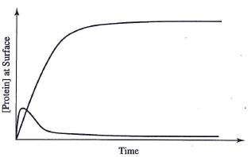
Example of Vroman Effect
Louisiana Tech University
College of Engineering and Science
If [A] is 4x higher than [B]
B has higher affinity than A
If [A] = [B]
B
A
Example Problem 8.4, Temenoff and Mikos (2008) Biomaterials text
Notes:
This is an example of how the plot of adsorbed proteins would look given two different ratios of Proteins A and B.

Slide 15
Formation of permanent protein layer
Louisiana Tech University
College of Engineering and Science
Eventually, conformational changes may promote covalent bonding with surface.
Also, proteins may form lateral networks:
very difficult for individual proteins to release
too many bonds to break at once for a layer to lift off
Notes:
For scenario 2, this is like trying to lift tape or Velcro by pulling straight up on it. You usually can’t remove it because of the great number of points of attachment. Likewise, it is extremely difficult and impractical to try to remove the adsorbed protein layer on an implanted device. It is best to prevent adsorption of unwanted proteins.

Slide 16
Intentional modification of surfaces
Louisiana Tech University
College of Engineering and Science
What can you imagine doing to a surface and why?

Slide 17
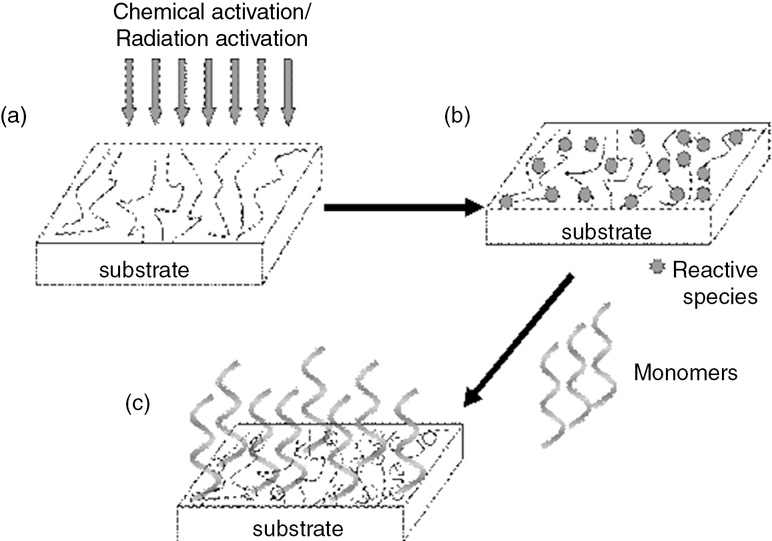
Grafting – general procedure
Louisiana Tech University
College of Engineering and Science
© 2014 C. M. Agrawal, J. L. Ong, M. R. Appleford and G. Mani
Agrawal et al., Figure 9.19
Notes:
(a) After careful surface preparation, (b) reactive species (molecules/atoms/…) can be intentionally applied to the surface. (c) Other molecules can then be attached to the reactive molecules. This method has been employed to change the interaction of materials with cells, tissue and in living animals. Dr. Murray used this approach for her Senior Design project to minimize scar tissue around implanted neural electrodes.

Slide 18
Louisiana Tech University
College of Engineering and Science
SAM and immobilized biomolecules
Oxidized dextran monolayer to prevent protein adsorption
Conjugate peptides to induce neuron ingrowth to electrodes
O
O
O
O
O
O
O
O
O
O
O
H
O
H
O
H
O
H
O
H
O
O
H
H
O
O
H
H
O
O
H
H
O
H
O
N
O
H
H
O
N
O
H
RGD
NGF
Surface of polyimide electrode array: plasma-cleaned and then adsorbed poly-D-lysine
M. Holecko, et al., c. 2001, used w permission for T.A. Murray, et al., Senior Design Presentation, 2001
Notes:
This is a diagram from Dr. Murray’s Senior Design project. The substrate is polyimide (a manmade polymer, shown as blue diagonal lines). The polyimide provided support and protective covering of electrodes for brain research. The problem with the electrodes was that scar tissue built up around the electrodes within a few weeks and then the electrical recordings from the brain faded to the point of being unusable.
It was suspected that proteins that adsorbed onto the polyimide surface and denatured (unfolded) were causing an immune response that eventually resulted in a scar around the electrode. Oxidized dextran had shown some promise of preventing protein adsorption. To apply this layer of dextran, the surface of the polyimide was cleaned with oxygen plasma which also activated the surface to bind polylysine, as short chain of the amino acid, lysine (pink wavy lines). The electrodes were placed in a solution containing polylysine for a day; the polylysine adsorbed onto the surface. Then, the treated electrodes were immersed in oxidized dextran (the black ringed structures in the diagram) for a couple of days. This molecular layer self assembled. This is know as a self-assembled monolayer, or simply as a SAM. The red starbursts represent a neuron attachment (RGD) and a nerve growth factor (NGF) that could be attached at a later time to help guide neurons to the electrode surface (these were not attached for the Senior Design project).

Slide 19
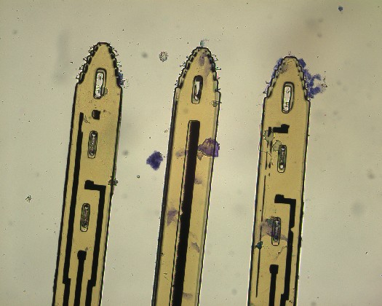
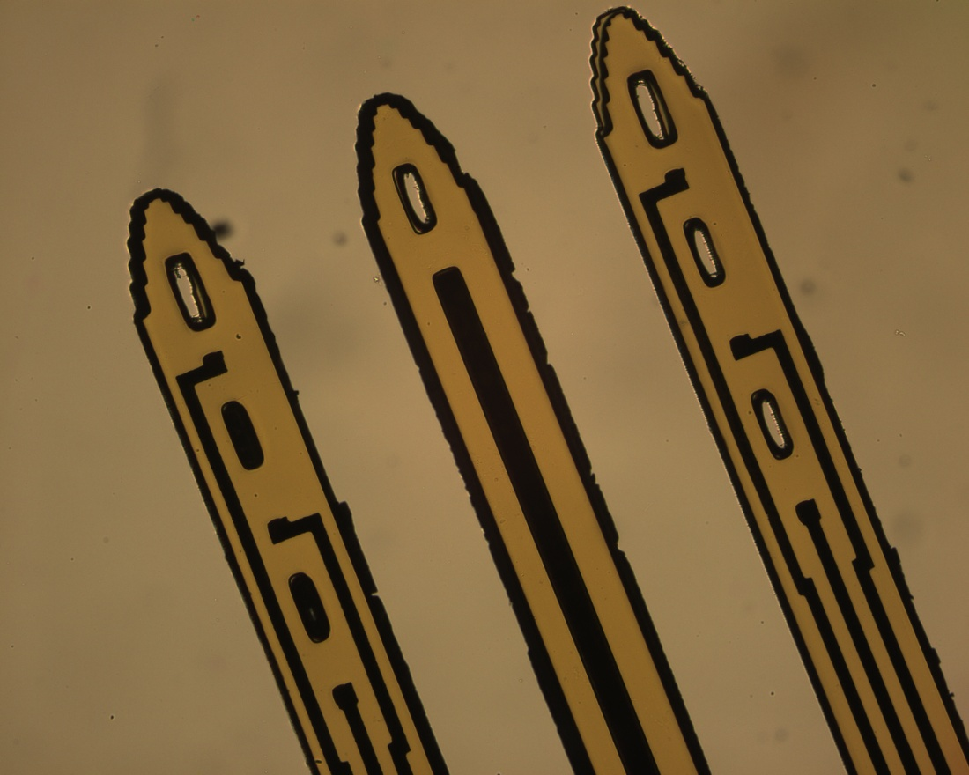
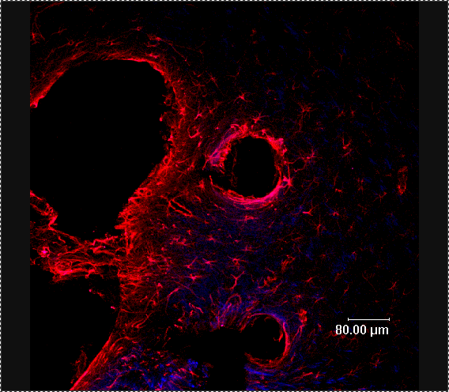
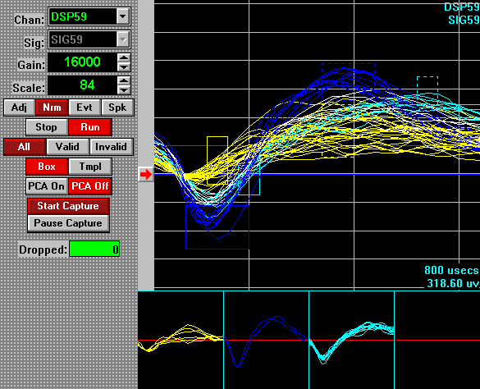
Oxidized dextran S.A.M. on electrodes
No S.A.M.
S.A.M.
Cells (stained purple) adhered to electrode surface
No cells adhered to electrode surface
T Murray 2002, unpublished
T Murray 2002, unpublished
Extensive encapsulation and inflammation (red stain), few neurons (blue stain)
Thin capsule, more neurons
Antibody stain colors are:
Astrocytes Neurons
Murray, T.A., et al., REAS 2003
Murray, T.A., et al., REAS 2003
Poor signal to noise ratio, likely due to encapsulation and exclusion of neurons
Good S:N likely due to larger numbers of neurons
Notes:
In vitro tests (tests with cells) were conducted to see if the oxidized dextran SAM on the electrode surface would prevent scar tissue formation (presumably by preventing protein adsorption and the subsequent immune response). After growing cells on electrodes with and without the dextran SAM, the cells were stained purple and a microscope was used to image the electrodes. The electrodes with no dextran SAM had cells growing on the electrodes. In contrast, the electrodes with the dextran did not have any cells growing on the electrodes.
In a second experiment, microwire electrodes with a polyimide insulation were implanted into rats. Half had the dextran SAM and half did not. After the electrodes had been implanted for a few weeks, they were removed and the brain tissue was stained for scar tissue formation (red) and for neurons (dark blue). The uncoated electrodes were surrounded by a very large scar while the coated electrodes had a very thin scar and many neurons near the electrodes. The untreated electrodes with the large scars produced very poor electrical recordings (low signal-to-noise ratio) whereas the treated electrodes had excellent signal-to-noise ratios.

Slide 20
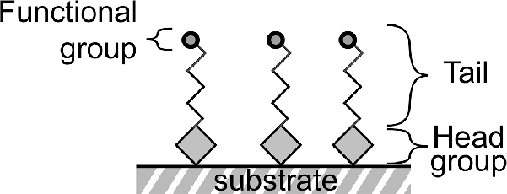
Functionalized S.A.M.
Louisiana Tech University
College of Engineering and Science
© 2014 C. M. Agrawal, J. L. Ong, M. R. Appleford and G. Mani
Agrawal et al., Figure 9.20
Notes:
We just saw an example of how a SAM can be used to prevent protein adsorption and improve the performance of an implanted device. There was no functional group added to the dextran. However, there could have been, as seen in the diagram two slides back with two red starbursts that denoted the potential addition of factors to promote neuron growth. Many different molecules can be added to SAMs that actively elicit desired reactions from the body. The generic name for these types of molecules is “functional group.” The functional group is usually at the end of a linker, or spacer. Together, the two are referred to as the tail. The spacer is needed so that the functional group is held away from the surface. This is to keep it from adsorbing onto the surface and denaturing (unfolding and becoming useless).
The head group is the reactive species shown 3 slides back.

Slide 21
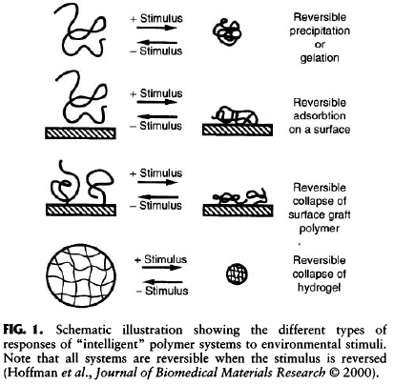
Louisiana Tech University
College of Engineering and Science
Stimulus responsive
polymers
Figures from Chapter 2.6, Ratner et al., 2004
Notes:
Stimulus responsive polymers change shape and size or density based on some stimulus. The stimulus could be high or low pH, a change in temperature, an applied electric or magnetic field and so on. (Read the captions.) The changes can release drugs held within the polymer, change the shape of an implant, pump fluids, and so forth.

Slide 22
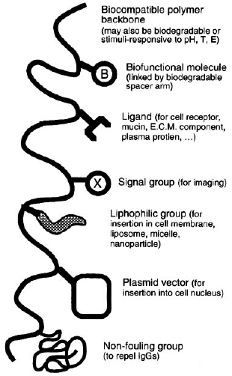
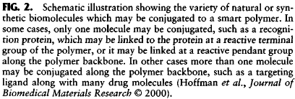
Louisiana Tech University
College of Engineering and Science
Biomolecules conjugated to smart polymers
Figure from Chapter 2.6, Ratner et al., 2004
Notes:
Many polymers, both natural and manmade, can be engineered to bind enzymes, growth factors, receptors (or their ligands), and many other biologically-relevant molecules. The diagram illustrates some of the possibili

Slide 23
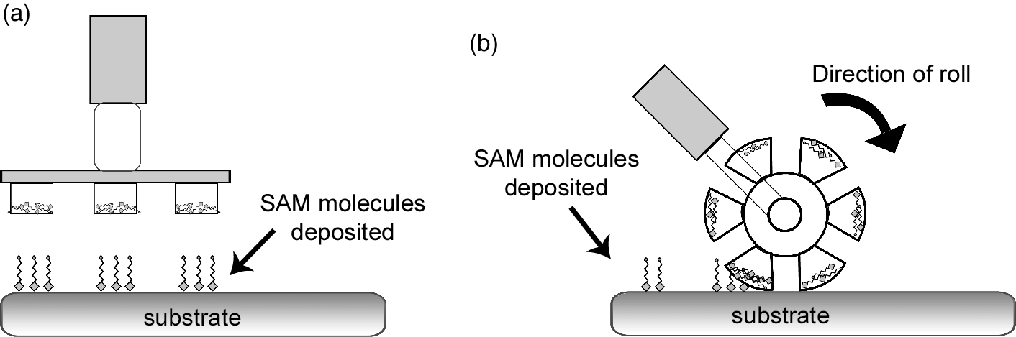
Micro-contact printing
Louisiana Tech University
College of Engineering and Science
Planar stamp
Rolling stamp
© 2014 C. M. Agrawal, J. L. Ong, M. R. Appleford and G. Mani
Agrawal et al., Figure 9.21
Notes:
As mentioned earlier, the surface must be prepared to immobilize a SAM or any other type of molecular surface treatment. To achieve patterning of SAMs, several types of techniques are useful. A stamp [often made from polydimethylsiloxane (PDMS)] can be used to apply a reactive species, or the SAM to a surface. Another method is to roll a pattern (b).

Slide 24
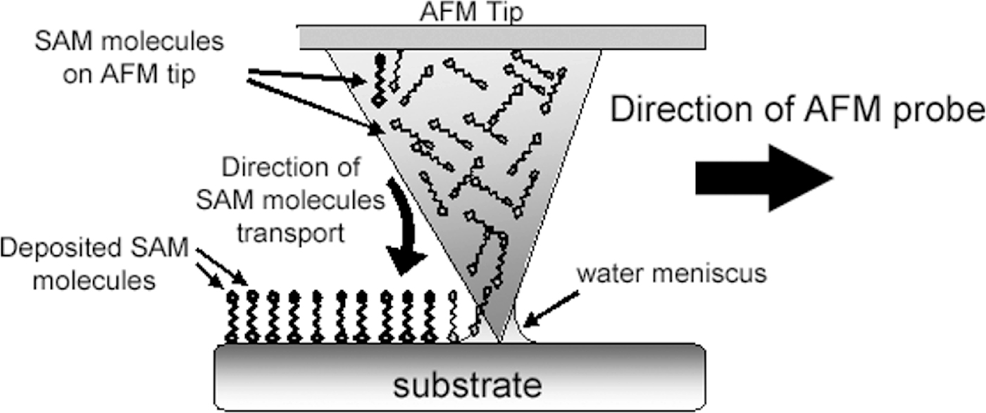
Dip-pen lithography
Louisiana Tech University
College of Engineering and Science
© 2014 C. M. Agrawal, J. L. Ong, M. R. Appleford and G. Mani
Agrawal et al., Figure 9.22
Notes:
For very small areas, dip-pen lithography can be used to very precisely place molecules on a surface. The tip of an atomic force microscope (AFM) can be used with high precision.

Slide 25
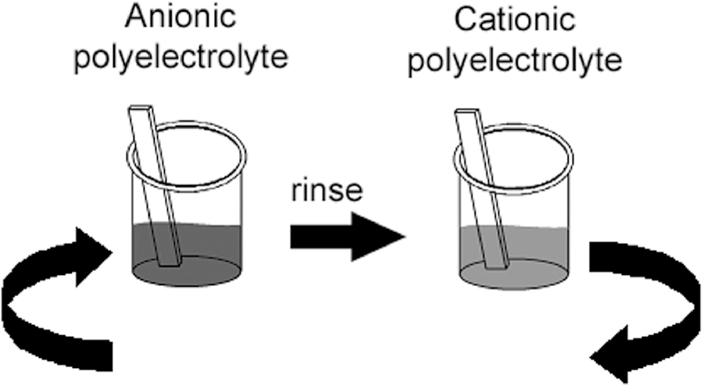
LbL dipping process
Louisiana Tech University
College of Engineering and Science
© 2014 C. M. Agrawal, J. L. Ong, M. R. Appleford and G. Mani
Agrawal et al., Figure 9.23
Notes:
LbL stands for layer-by-layer. The LbL process coats polyelectrolyts onto a material to protect a surface, change the properties of a surface or to coat drug particles for timed or environmentally-responsive release. Polyelectrolytes are chains of charged molecules. Anionic polyelectrolytes are negatively charged and cationic polyelectrolytes are positively charged. A material (or drug particle) is dipped into a polyelectrolyte solution with one charge and then excess polyelectrolyte is rinsed off. It is then immersed in the oppositely charged polyelectrolyte and rinsed. This procedure is repeated several times.

Slide 26
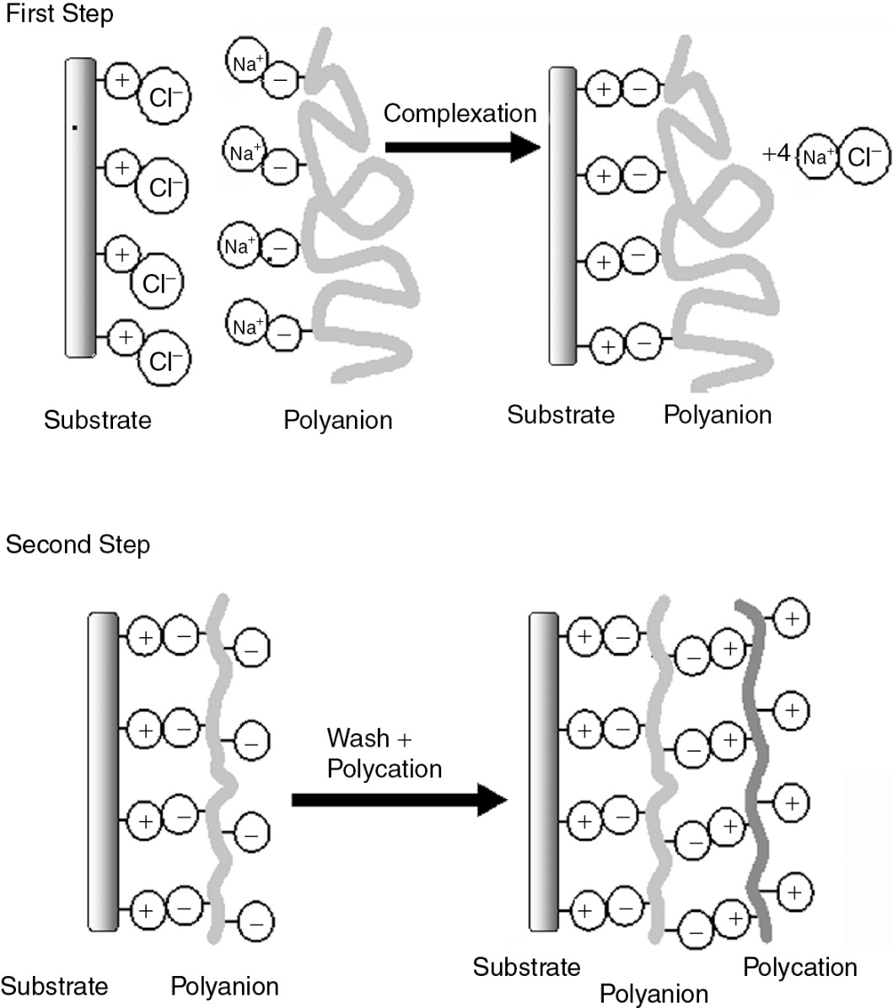
Simplified complexation diagram using LbL
Louisiana Tech University
College of Engineering and Science
© 2014 C. M. Agrawal, J. L. Ong, M. R. Appleford and G. Mani
Agrawal et al., Figure 9.24
Notes:
This shows how the layers bind.

Slide 27
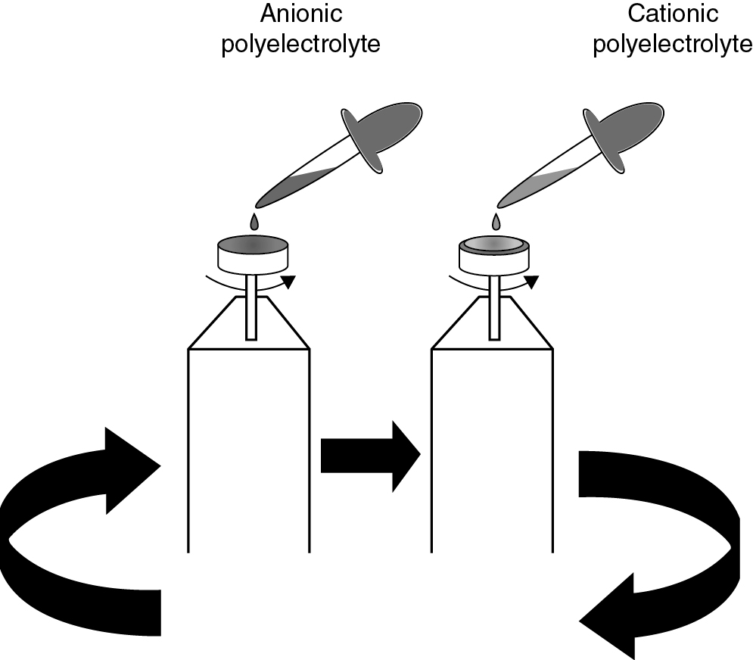
Multilayer film deposition – spin coating with LbL
Louisiana Tech University
College of Engineering and Science
© 2014 C. M. Agrawal, J. L. Ong, M. R. Appleford and G. Mani
Agrawal et al., Figure 9.25
Notes:
Instead of immersing parts in polyionic solutions, alternating layers can be applied by dropping a polyanion solution on the material while it spins.

Slide 28
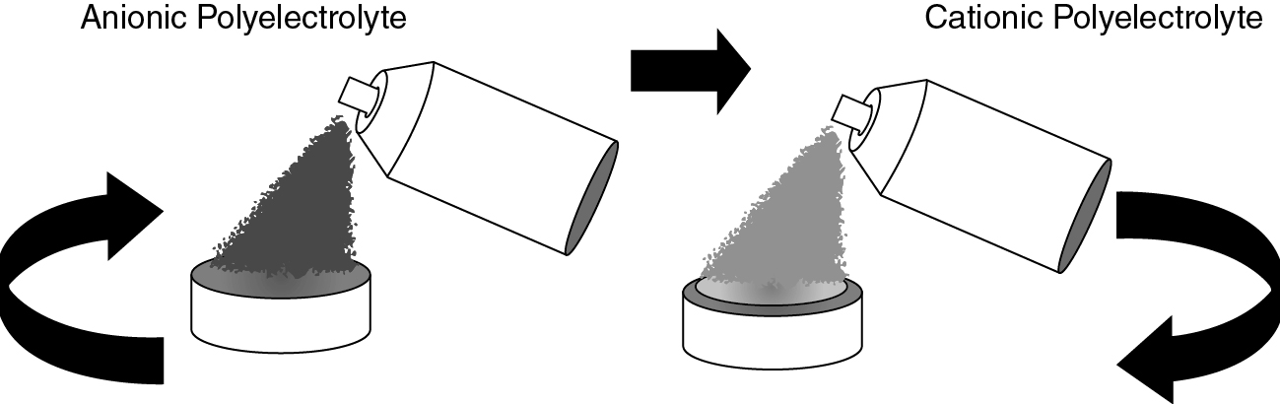
Spray-LbL assembly
Louisiana Tech University
College of Engineering and Science
© 2014 C. M. Agrawal, J. L. Ong, M. R. Appleford and G. Mani
Agrawal et al., Figure 9.26
Notes:
Another way to apply polyelectrolytes is to use pray bottles.

Slide 29
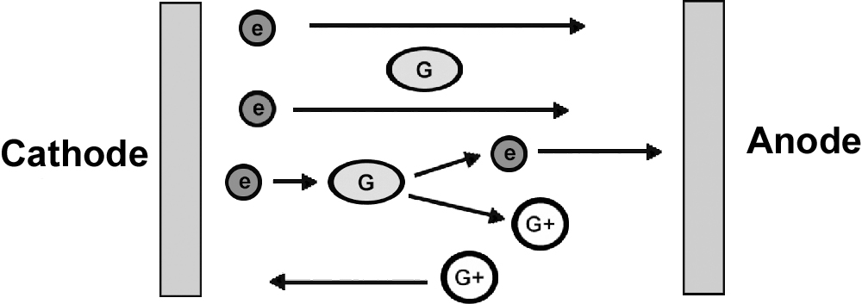
Direct current glow discharge
Louisiana Tech University
College of Engineering and Science
© 2014 C. M. Agrawal, J. L. Ong, M. R. Appleford and G. Mani
Agrawal et al., Figure 9.3
Notes:
The next several slides show some of the equipment that is used for modifying the surface of biomaterials. This slide shows how molecules aer bound to the surface using direct current glow discharge.

Slide 30
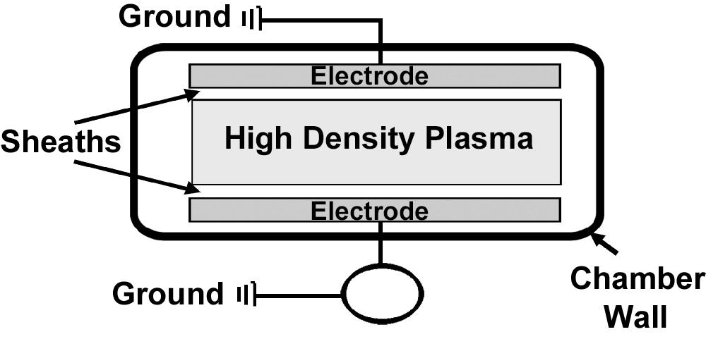
Capacitively coupled radiofrequency glow discharge
Louisiana Tech University
College of Engineering and Science
© 2014 C. M. Agrawal, J. L. Ong, M. R. Appleford and G. Mani
Agrawal et al., Figure 9.4
Notes:
This is similar to the last slide except that capacitively coupled radio frequency is used to treat the surface.

Slide 31
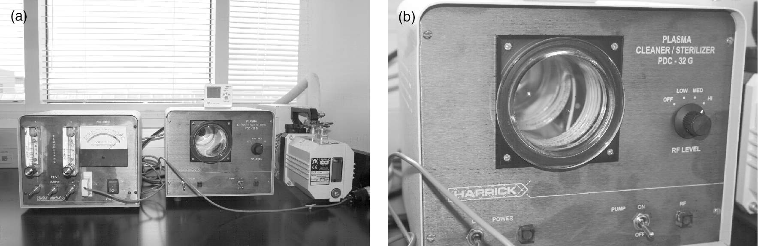
Inductively coupled radiofrequency glow discharge
Louisiana Tech University
College of Engineering and Science
© 2014 C. M. Agrawal, J. L. Ong, M. R. Appleford and G. Mani
Agrawal et al., Figure 9.5
Notes:
This is similar to the last slide except that inductively coupled radio frequency is used to treat the surface.

Slide 32
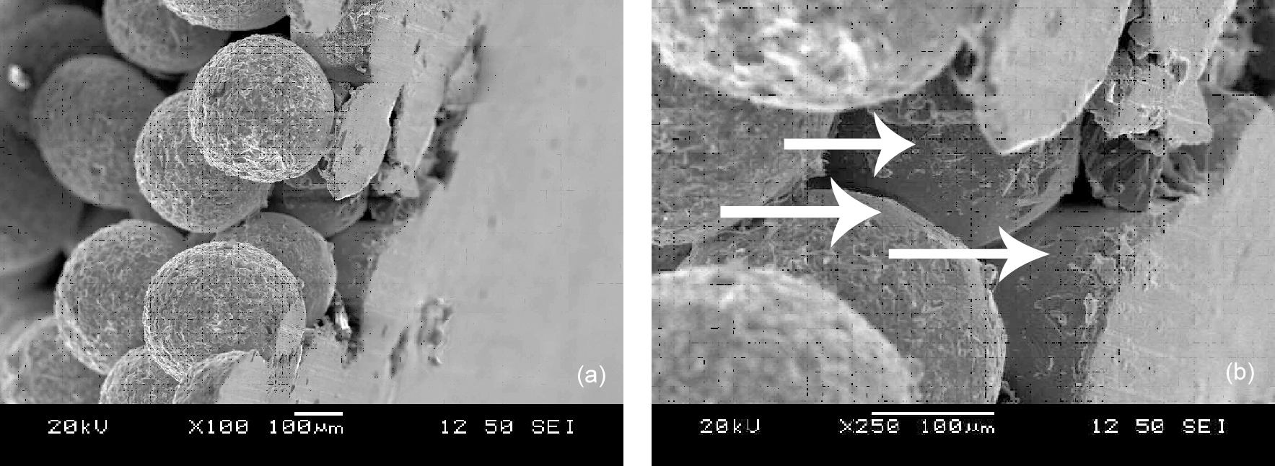
Inductively coupled radiofrequency glow discharge
Louisiana Tech University
College of Engineering and Science
© 2014 C. M. Agrawal, J. L. Ong, M. R. Appleford and G. Mani
Agrawal et al., Figure 9.8
Notes:
This technique can be used to apply small spheres onto the surface of orthopedic impants.

Slide 33
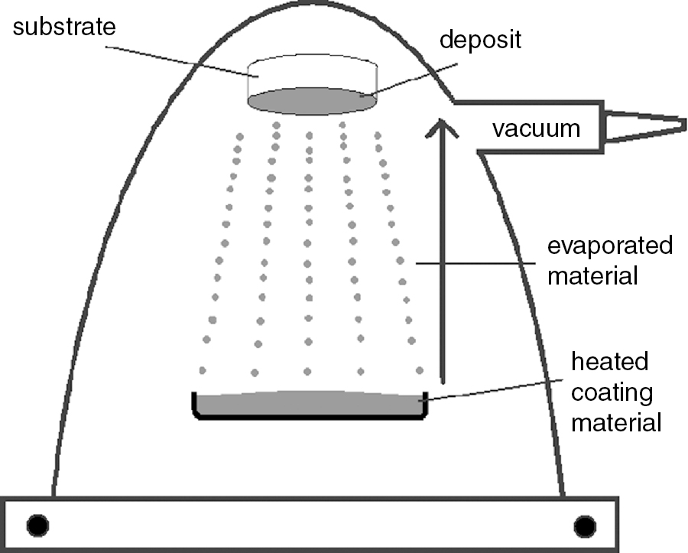
Evaporative deposition under high vacuum
Louisiana Tech University
College of Engineering and Science
© 2014 C. M. Agrawal, J. L. Ong, M. R. Appleford and G. Mani
Agrawal et al., Figure 9.12

Slide 34
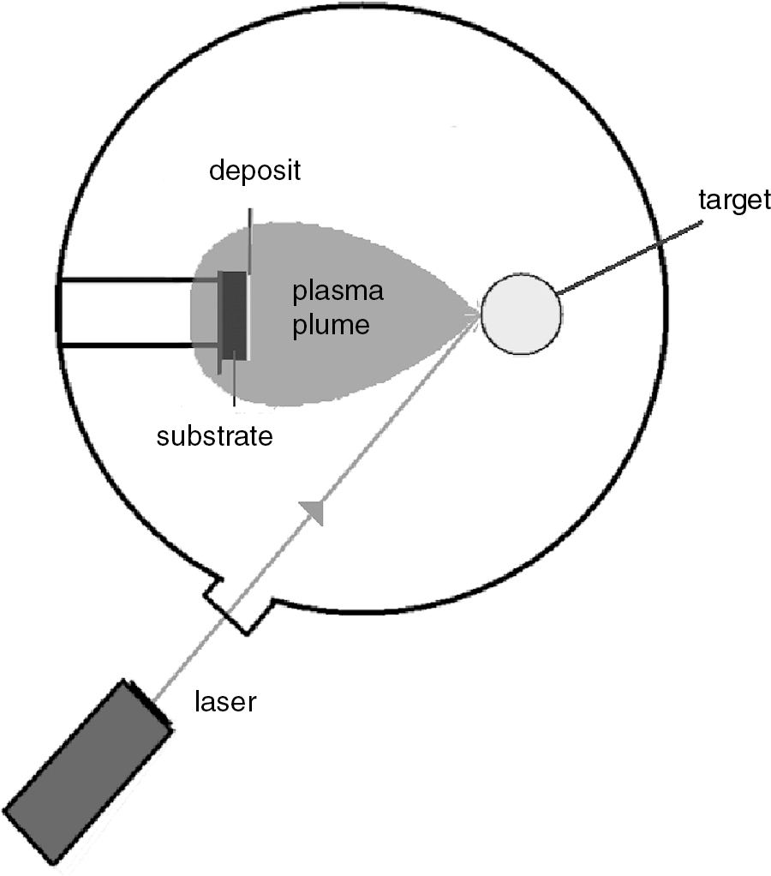
Evaporative deposition under high vacuum
Louisiana Tech University
College of Engineering and Science
© 2014 C. M. Agrawal, J. L. Ong, M. R. Appleford and G. Mani
Agrawal et al., Figure 9.13

Slide 35
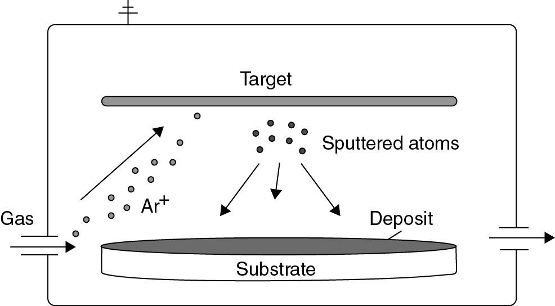
Sputter deposition under high vacuum
Louisiana Tech University
College of Engineering and Science
© 2014 C. M. Agrawal, J. L. Ong, M. R. Appleford and G. Mani
Agrawal et al., Figure 9.14

Slide 36
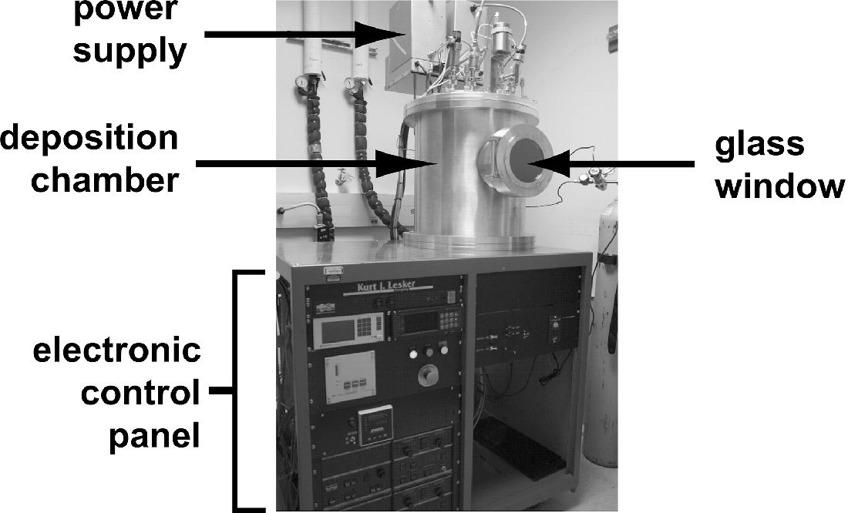
Radiofrequency magnetron sputter coater
Louisiana Tech University
College of Engineering and Science
© 2014 C. M. Agrawal, J. L. Ong, M. R. Appleford and G. Mani
Agrawal et al., Figure 9.15

Slide 37
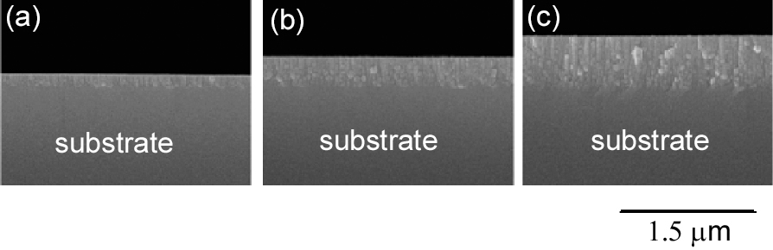
SEM of surface coated with radiofrequency magnetron sputtered Ti
Louisiana Tech University
College of Engineering and Science
1 hr.
2 hr.
3 hr.
© 2014 C. M. Agrawal, J. L. Ong, M. R. Appleford and G. Mani
Agrawal et al., Figure 9.16
Notes:
SEM is scanning electron microscope.

